Slide 1

CLIMATE ANALYSIS · MALI
Changes and
Variability in Mali’s Annual Temperature Cycle
Historical analysis: 1960–2014
Future projections: 2015–2050 under CMIP6 scenarios
Presented by : Founè BERTHÉ
Notes:
Good morning, everyone.
My name is Founè Berthé. Today I will show you my research on temperature change in Mali.
I study the past, from 1960 to 2014, and the future, from 2015 to 2050.
I compare two climate models and three future scenarios.
First, a few words about Mali, and then we go step by step: why, data, method, results, and conclusion.

Slide 2
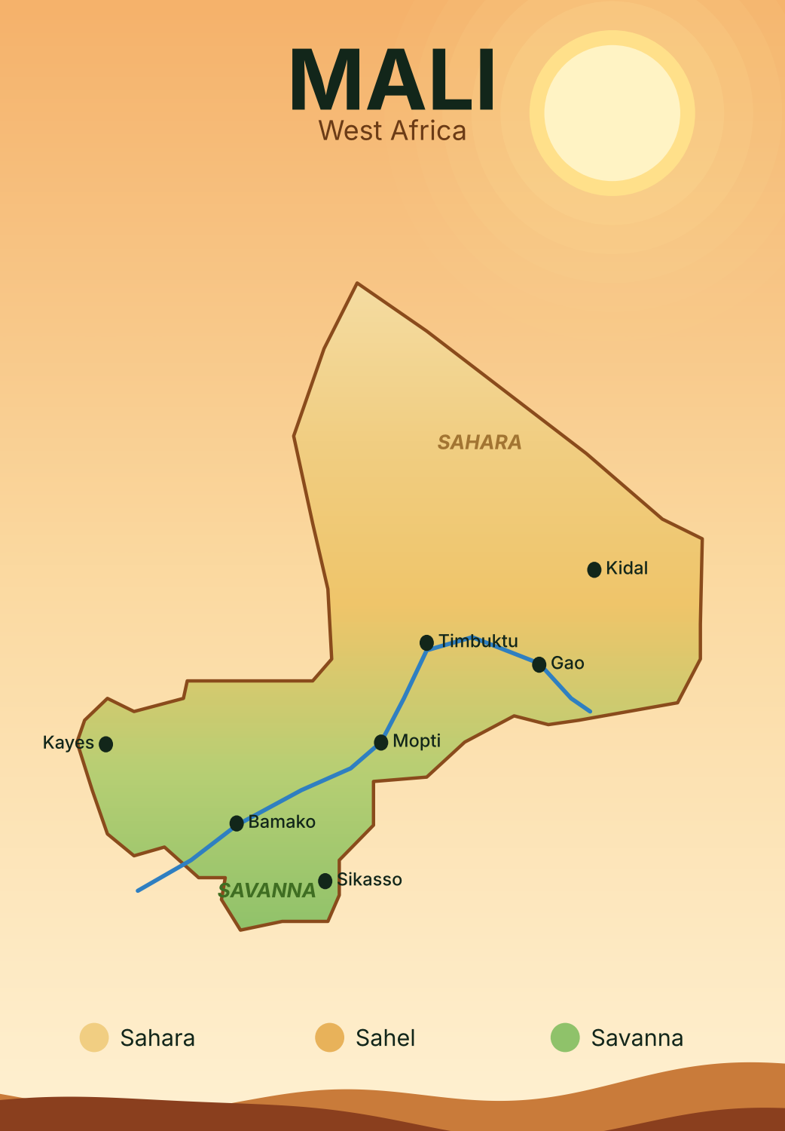
ABOUT MALI
Mali at a glance
Mali is a large country in West Africa. It has no sea coast. Its capital is Bamako.
It covers about 1.24 million km². About 23 million people live there.
The north is Sahara desert, the centre is the Sahel, and the south is greener savanna.
Most people work in farming. The Niger River gives water.
Notes:
Before the results, let me say a few words about Mali.
Mali is a big country in West Africa. It has no sea coast. The capital city is Bamako.
It covers about 1.24 million square kilometres, and about 23 million people live there.
The north is part of the Sahara desert. The centre is the Sahel, a dry zone. The south is greener, with savanna.
Most people work in farming, and they depend on rain and on the Niger River.
This is why temperature change matters so much here: a hotter climate can affect crops, water and daily life.
Next: why this study matters.

Slide 3
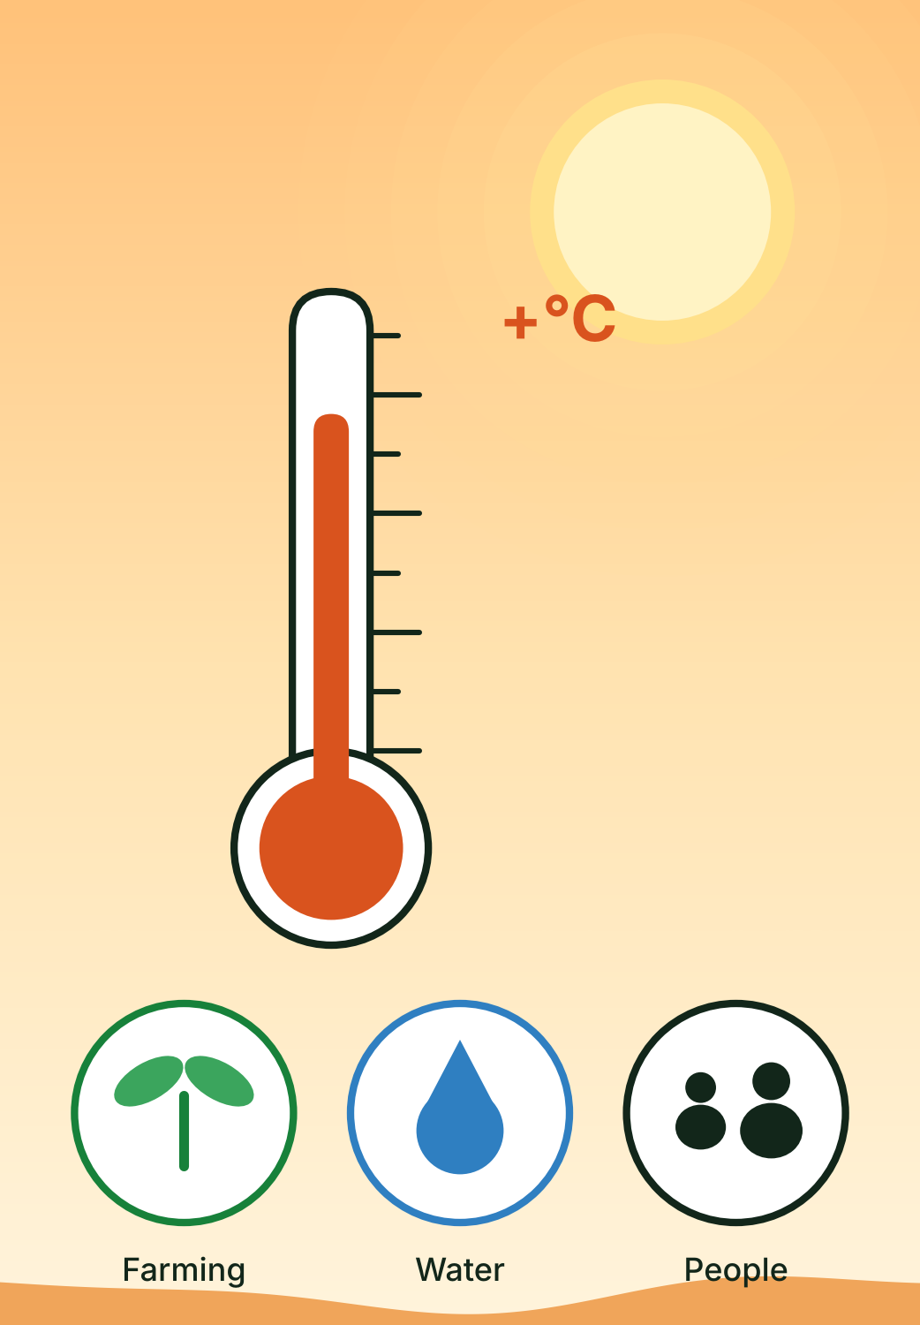
01 · PURPOSE
Why this study matters and what it tests
The world is getting warmer. Mali is exposed to rising temperatures and changing weather.
Warmer weather can affect farming, water and daily life.
Main goal: study past temperature trends in Mali and see how they may change in the future.
I compare yearly mean temperature, TGx (warmest day), TGn (coolest day), two models and three scenarios.
Notes:
Why is this study important?
The world is getting warmer, and Mali is one of the places that feels it strongly.
Higher temperatures can hurt farming, reduce water, and make daily life harder.
So my main goal is simple: to look at how temperature changed in the past, and how it may change in the future.
To do this, I look at three indicators: the yearly mean temperature, TGx, which is the warmest day of the year, and TGn, which is the coolest day of the year.
I compare two climate models and three future scenarios.
Next: the data I used.

Slide 4
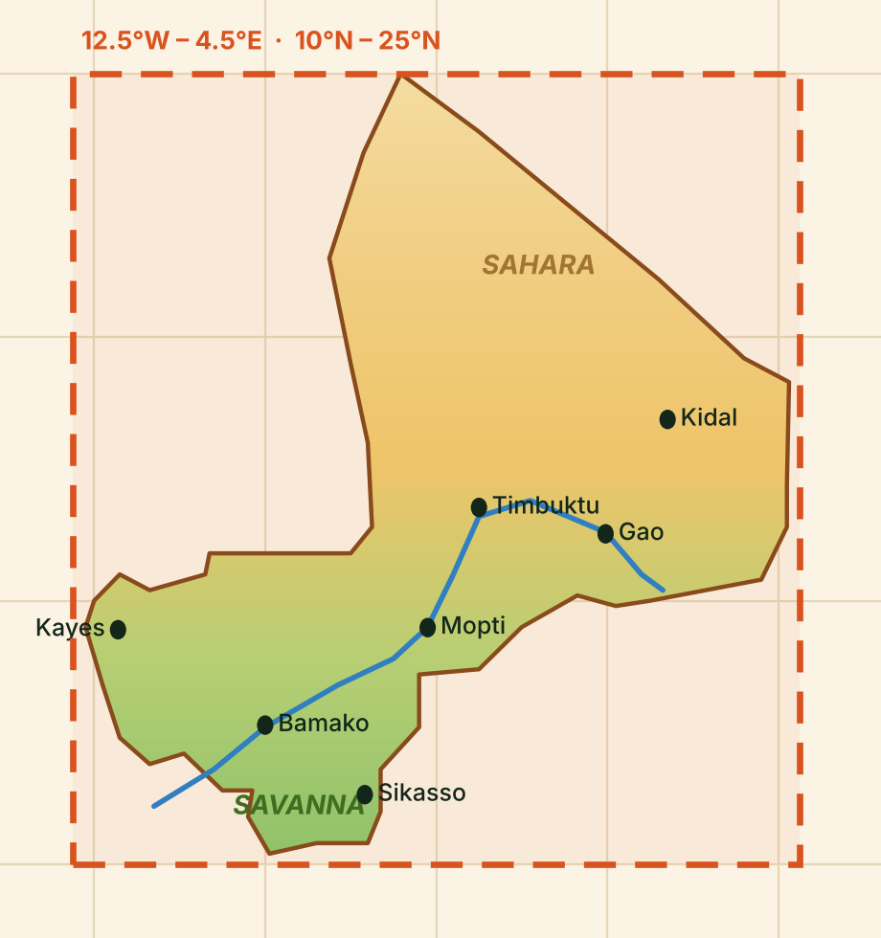
02 · DATA AND DOMAIN
CMIP6 data and the study domain
Variable: tas, the daily mean air temperature. I changed it from Kelvin to degrees Celsius.
Models: ACCESS-CM2 (ACCESS) and MPI-ESM1-2-HR (MPI).
Periods: historical 1960–2014; future 2015–2050.
Scenarios: SSP126, SSP245, and SSP585.
Domain: 12.5°W–4.5°E and 10°N–25°S. It is a rectangle around Mali, not the exact border.
Orange box = study domain. Map is simplified.
Notes:
Here is the data.
I use CMIP6 climate model data. The main variable is tas, the daily mean air temperature. I changed it from Kelvin to degrees Celsius so it is easy to read.
I use two models: ACCESS-CM2 and MPI-ESM1-2-HR. I call them ACCESS and MPI.
The past period is 1960 to 2014. The future period is 2015 to 2050.
There are three future scenarios. SSP126 is low emissions, SSP245 is medium, and SSP585 is high.
The study area is a rectangle: from 12.5 degrees West to 4.5 degrees East, and from 10 degrees North to 25 degrees North.
Please note: this rectangle covers Mali, but it is not the exact national border.

Slide 5
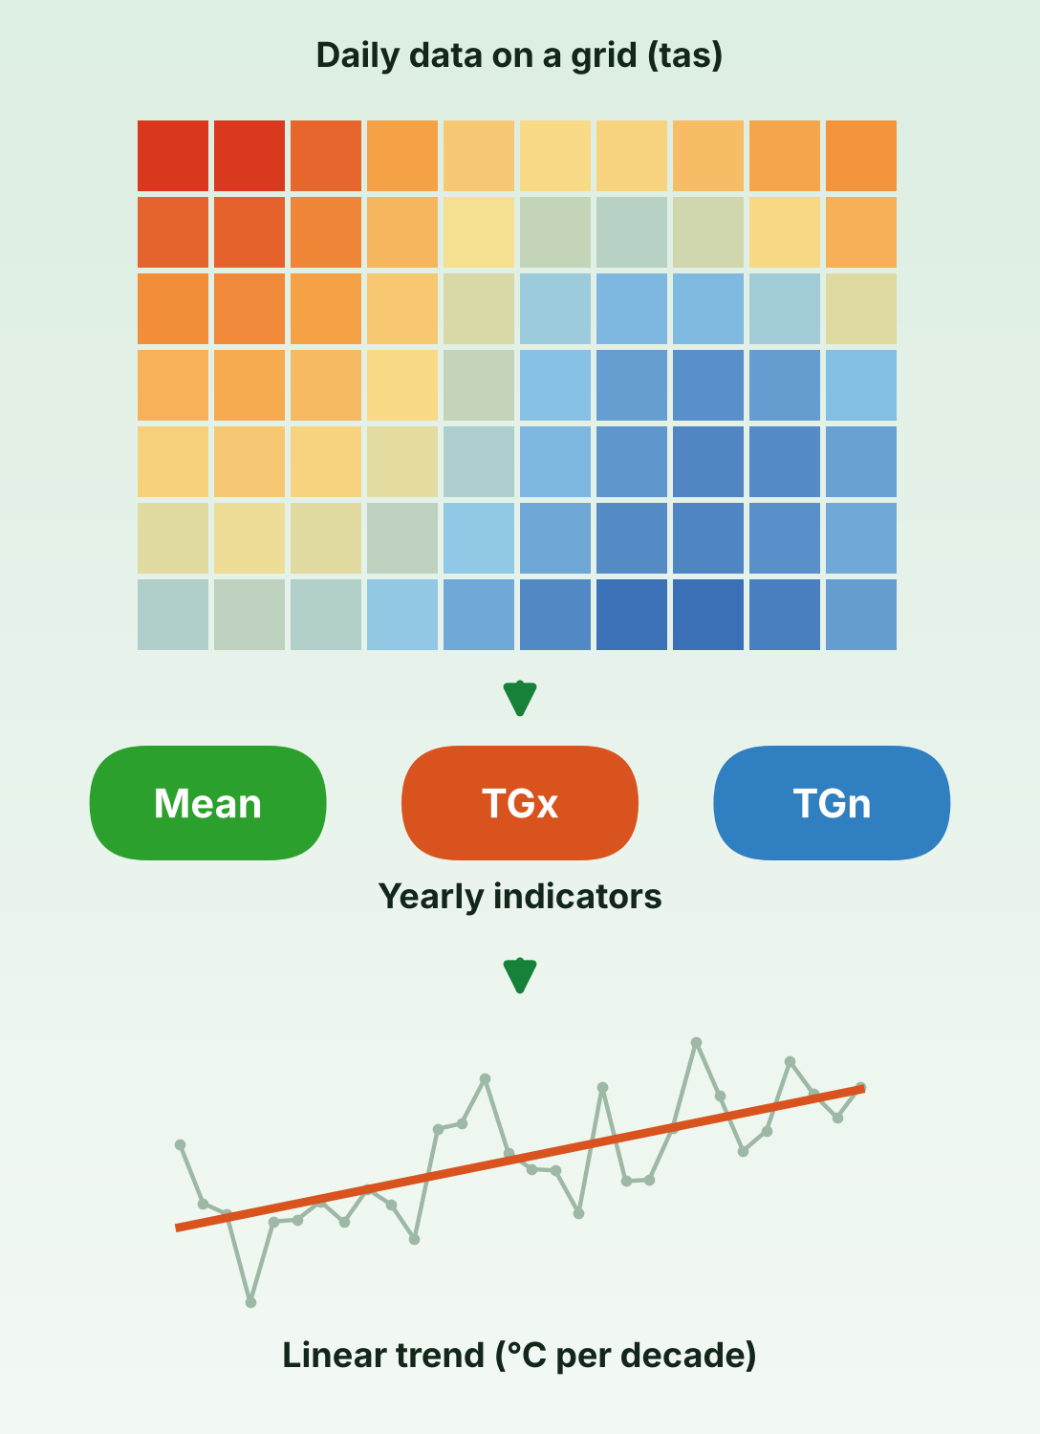
03 · METHOD
From daily tas to annual indicators and trends
Collect daily CMIP6 temperature data.
Extract the selected geographical domain.
Convert Kelvin to Celsius.
Calculate annual mean temperature.
Calculate TGx and TGn at each grid cell.
Calculate spatial means.
Calculate ensemble mean: (ACCESS + MPI) / 2.
Analyse trends using linear regression.
TGx: the warmest day of the year · TGn: the coolest day of the year · Both use daily mean temperature (tas), not tasmax or tasmin.
Notes:
This slide shows my method in eight simple steps.
One: collect the daily temperature data. Two: cut out the study area. Three: change Kelvin to Celsius.
Four: calculate the yearly mean temperature. Five: calculate TGx and TGn for each grid cell.
Six: average over the whole area. Seven: make the ensemble mean, which is simply the average of ACCESS and MPI.
Eight: use linear regression to measure the trend. The trend tells us how many degrees the temperature changes every ten years.
Remember: TGx is the warmest day of each year, and TGn is the coolest day of each year. Both come from daily mean temperature, not from tasmax or tasmin.
Now let's look at the results.

Slide 6
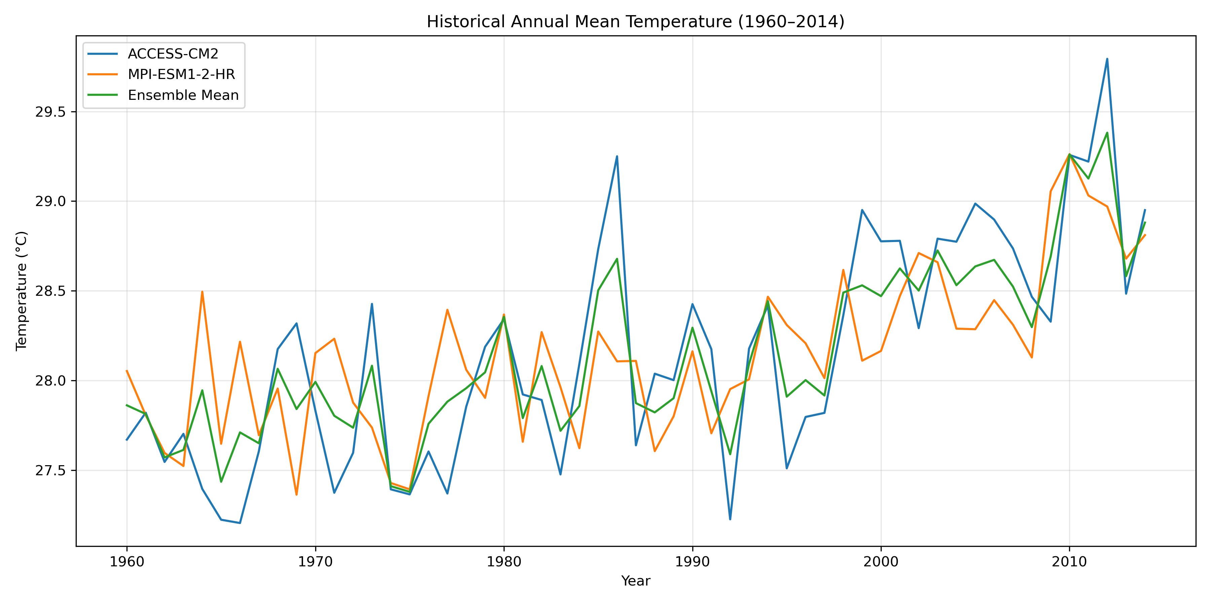
04 · HISTORICAL RESULTS
Historical annual mean temperature is increasing
Ensemble trend
+0.23 °C
every 10 years
● ACCESS-CM2
● MPI-ESM1-2-HR
● Ensemble (average of both)
All trends are positive: the area warmed from 1960 to 2014.
How to read it: Each line shows the yearly mean temperature for one model. The lines go up over time, so Mali is getting warmer.
Notes:
Now the first result: the historical yearly mean temperature, from 1960 to 2014.
How to read this graph: the blue line is ACCESS, the orange line is MPI, and the green line is the ensemble, the average of the two models.
The lines go up and down from year to year. This is normal climate variability.
But look at the big picture: all lines move up over time.
The ensemble trend is about +0.23 degrees Celsius every ten years. Over 55 years, this is a clear warming.
Key message: Mali's area already became warmer in the past.
Next, we look at the extremes: the warmest and coolest days.

Slide 7
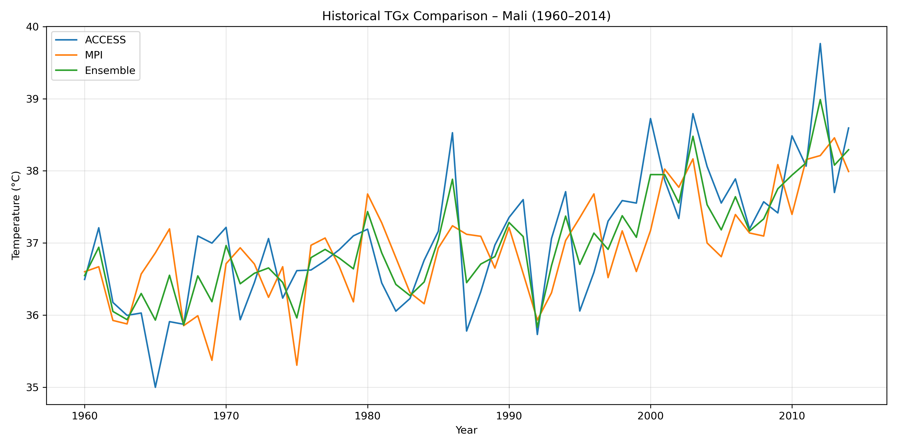
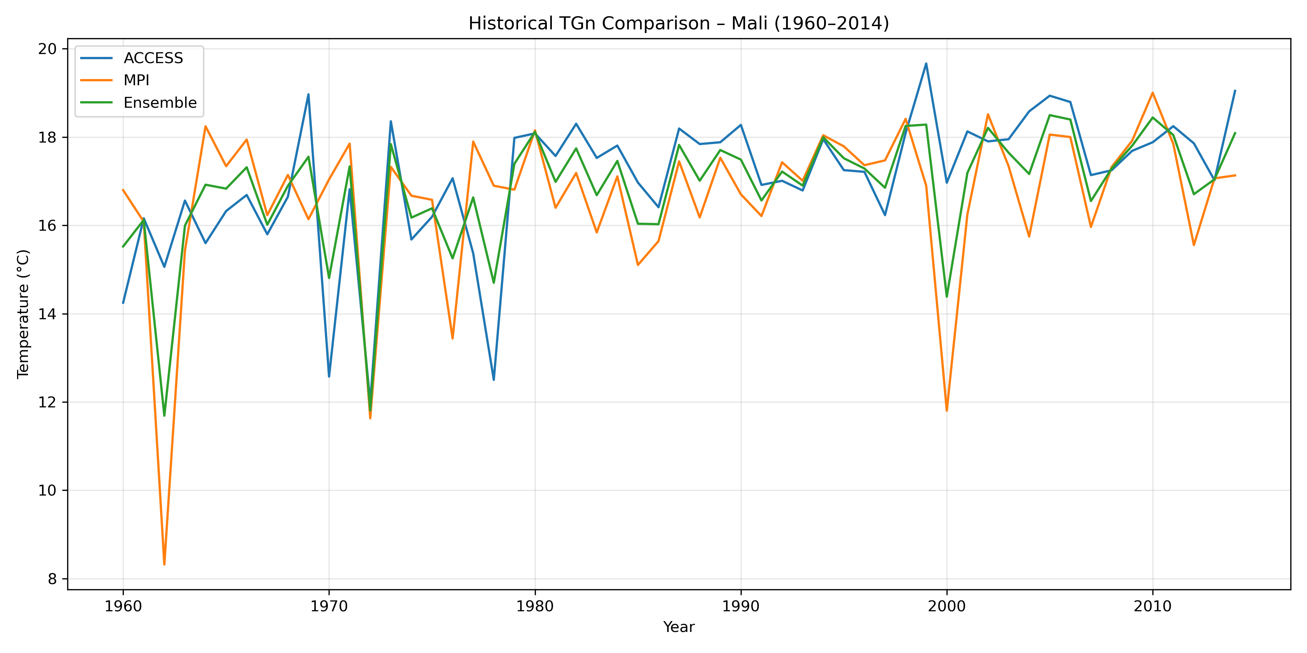
05 · HISTORICAL EXTREMES
Historical TGx and TGn also show warming
ACCESS: +0.3958 · MPI: +0.2954 · Ensemble: +0.3456 °C/decade.
ACCESS: +0.5299 · MPI: +0.2935 · Ensemble: +0.4117 °C/decade.
TGx is the warmest day of each year. The lines go up, so the hottest days are getting hotter.
TGn is the coolest day of each year. It also goes up, so the coolest days are getting warmer.
Note: for MPI, the TGn trend is not statistically significant at 5% (p = 0.0549).
Notes:
This slide shows the extremes. On the left is TGx, the warmest day of each year. On the right is TGn, the coolest day of each year.
Colours are the same as before: blue is ACCESS, orange is MPI, green is the ensemble.
Both graphs go up. The ensemble trend is +0.35 degrees every ten years for TGx, and +0.41 degrees every ten years for TGn.
In simple words: the hottest days are getting hotter, and the coolest days are getting warmer.
One important detail: for MPI, the TGn trend is not statistically significant at the 5 percent level, because p is 0.0549. It is very close, but it does not pass the test.
Key message: warming is seen in the mean and in the extremes.
Now let's look at the future.

Slide 8
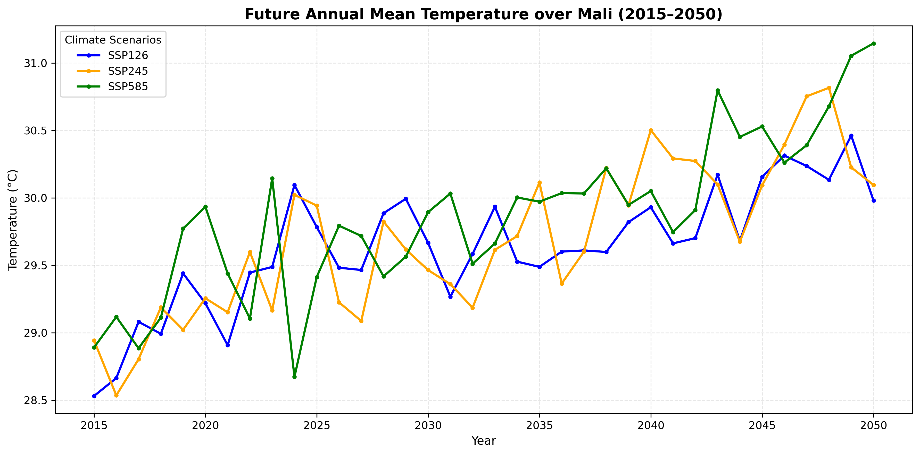
06 · FUTURE MEAN TEMPERATURE
SSP585 gives the strongest future mean-warming trend
Strongest trend (SSP585)
+0.47 °C
every 10 years (ensemble)
● SSP126: low emissions
● SSP245: medium emissions
● SSP585: high emissions
More emissions means more warming.
How to read it: Each line is one scenario. All lines go up, and the green line (highest emissions) rises the most.
Notes:
Now the future, from 2015 to 2050. This graph shows the ensemble mean for the three scenarios.
How to read it: blue is SSP126, low emissions. Orange is SSP245, medium emissions. Green is SSP585, high emissions.
All three lines go up. But the green line, SSP585, goes up the most.
The ensemble trend under SSP585 is about +0.47 degrees Celsius every ten years. This is the strongest of the three.
The lines also move up and down from year to year. This is natural variability, so we look at the general direction, not at one single year.
Key message: the more greenhouse gases we emit, the more Mali will warm.

Slide 9
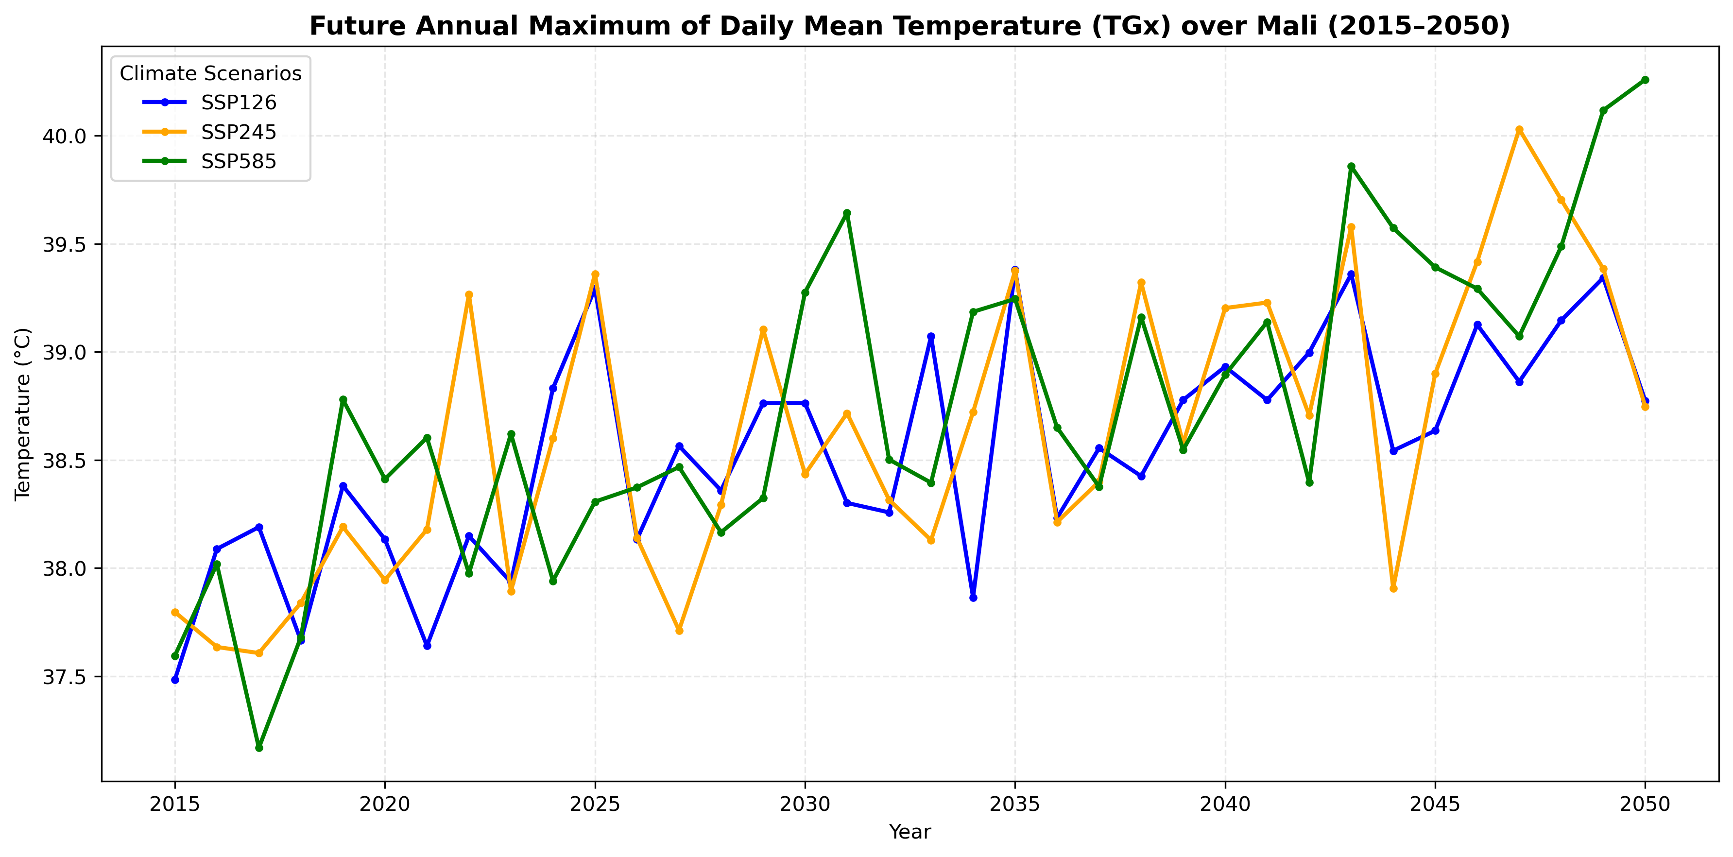
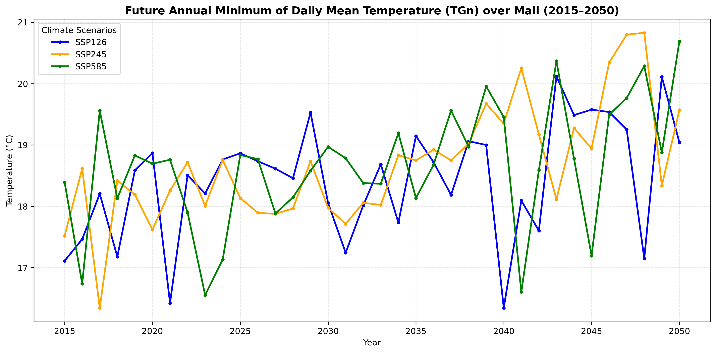
07 · FUTURE EXTREMES
Future TGx and TGn respond differently by scenario
TGx is the warmest day of each year. It rises in all scenarios. The strongest trend is under SSP585.
TGn is the coolest day of each year. It rises too. The strongest trend is under SSP245.
Colours: ● SSP126 ● SSP245 ● SSP585
Notes:
These two graphs show the future warmest day, TGx, on the left, and the future coolest day, TGn, on the right.
Colours: blue is SSP126, orange is SSP245, green is SSP585.
Both TGx and TGn go up in the future. So the hottest days will be hotter, and the coolest days will be warmer.
But they do not react in the same way to each scenario.
For TGx, the strongest trend is under SSP585, the high emissions scenario.
For TGn, the strongest trend is under SSP245, the medium scenario.
So we cannot say that one scenario is always the strongest. It depends on the indicator.
Next, one slide with all the graphs together.

Slide 10
ALL RESULTS
All graphs and models on one slide
Historical mean · +0.23 °C/decade
Historical TGx · +0.35 °C/decade
Historical TGn · +0.41 °C/decade
Future mean · strongest: SSP585
Future TGx · strongest: SSP585
Future TGn · strongest: SSP245
Models: ACCESS-CM2 and MPI-ESM1-2-HR, plus their ensemble mean (the average of the two).
Scenarios: SSP126 = low emissions · SSP245 = medium · SSP585 = high.
Notes:
This slide puts all the graphs together, so we can compare them at a glance.
The top row is the past, from 1960 to 2014: the mean temperature, TGx and TGn.
The bottom row is the future, from 2015 to 2050: the same three indicators.
Every graph goes up. This is the main message of my study.
At the bottom you can see the models and scenarios. We use two models, ACCESS and MPI, and their ensemble mean, which is the average of both.
We use three scenarios: SSP126 for low emissions, SSP245 for medium, and SSP585 for high.
The numbers above each graph are the ensemble trends, in degrees Celsius per decade, or the scenario with the strongest trend.
Now let's put numbers on the total change between the two periods.

Slide 11
08 · PERIOD AVERAGES
Future averages are warmer than historical averages
How much warmer is 2015–2050 than 1960–2014? These are ensemble mean differences.
These are differences between two period averages, not projected temperatures specifically in 2050.
Indicator | SSP126 | SSP245 | SSP585
Mean temperature | +1.49 °C | +1.55 °C | +1.72 °C
TGx | +1.55 °C | +1.63 °C | +1.75 °C
TGn | +1.59 °C | +1.81 °C | +1.82 °C
Simple message: SSP585 gives the biggest warming in every row, and all values are above +1.4 °C.
Notes:
This table compares two long periods: the past, 1960 to 2014, and the future, 2015 to 2050. It uses the ensemble mean.
Read each row from left to right. For the mean temperature, the future is warmer by +1.49 degrees under SSP126, +1.55 under SSP245, and +1.72 under SSP585.
TGx and TGn show the same story, with values between +1.55 and +1.82 degrees.
SSP585 is the highest in every row. For TGn, SSP245 and SSP585 are almost the same: +1.81 and +1.82.
Please remember: these are differences between two period averages. They are not the temperature in the year 2050.
Key message: even in the low scenario, the future average is almost 1.5 degrees warmer than the past.

Slide 12
09 · CONCLUSION
Warming is consistent, but the analysis has clear limits
Historical annual mean temperature, TGx, and TGn show increasing trends.
Future projections indicate warming under all three scenarios.
ACCESS generally projects stronger historical trends than MPI.
Main message: Mali is warming, and it may warm more.
Notes:
Let me finish with the main messages.
One: in the past, the mean temperature, TGx and TGn all went up.
Two: in the future, temperatures go up under all three scenarios. The high-emissions scenario, SSP585, gives the strongest warming for the mean.
Three: ACCESS generally shows stronger past trends than MPI.
This study has limits: the area is a rectangle and not the exact border of Mali, I use only two models, and I did not use a precise national mask.
Next steps: add more models and a precise national mask.
If we remember one thing: Mali is warming, and it may warm more if emissions stay high.

Slide 13
THE END
Thank you!
Questions?
Founè BERTHÉ
Changes and Variability in Mali’s Annual Temperature Cycle
Notes:
Thank you very much for your attention.
I showed you that Mali's area has warmed in the past, and that more warming is expected in the future, especially if emissions stay high.
I am now happy to answer your questions and to hear your comments.
(If there are no questions at first, you can start with: Which result surprised you most? Or: Why does the scenario matter so much?)

